Slide 1
BRICS Data Analysis Project
About the data
Julian Klauder

Slide 2
Data Source
The World Bank is the data’s source
The mission of the World Bank’s Development Data Group is to provide high-quality national and international statistics to clients within and outside the Bank and to improve the capacity of member countries to produce and use statistical information. As part of the international statistical system, the Data Group works with other organizations on new statistical methods, data collection activities and statistical capacity-building programs.
Data collection method
Much of the data comes from the statistical systems of member countries, and the quality of global data depends on how well these national systems perform. The World Bank works to help developing countries improve the capacity, efficiency and effectiveness of national statistical systems. Without better and more comprehensive national data, it is impossible to develop effective policies, monitor the implementation of poverty reduction strategies, or monitor progress towards global goals.
https://data.worldbank.org/about

Slide 3
Columns
Dimensions: Country Year: from 1999 to 2019 Continent: names of the different continents brics_g7: flag with values: brics, g7, and NaN
Measures: Life Expectancy Population CO2 emissions Health expenditure Forest area GDP per capita Individuals using the Internet Military expenditure Beer consumption per capita

Slide 4
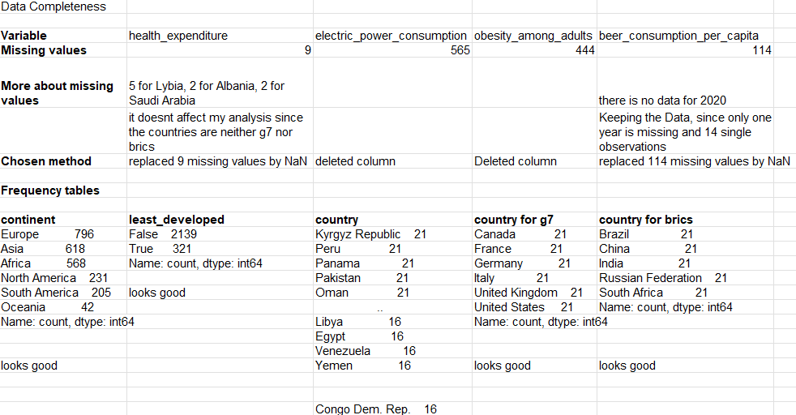
Data Completeness Check

Slide 5
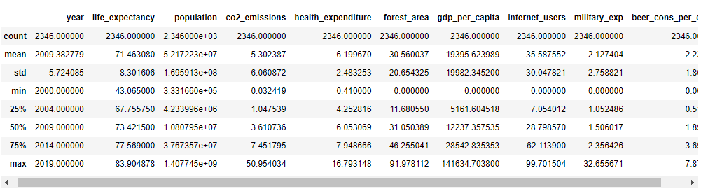
Data Profile

Slide 6
Limitations
Much of the data comes from the statistical systems of member countries, and the quality of global data depends on how well these national systems perform.

